Slide 1
Streaming Social Media Data with R
Iuliia Alieva
Research Assistant
School of Journalism
University of Missouri

Slide 2
rtweet
R client for accessing Twitter’s REST and stream APIs. Check out the rtweet package documentation website https://rtweet.info/
rtweet should be used in strict accordance with Twitter’s developer terms.
All you need is a Twitter account (user name and password) and you can be up in running in minutes!

Slide 3
rtweet
It is no longer necessary to obtain a developer account and create your own Twitter application to use Twitter’s API.
You may still choose to do this (gives you more stability and permissions), but rtweet should work out of the box assuming (a) you are working in an interactive/live session of R and (b) you have installed the httpuv package.

Slide 4
developer.twitter.com
To create your own token (with write and DM-read access), users must...
Apply and get approved for a developer account with Twitter
Create a Twitter app (fill out a form)
For step-by-step instructions on how to create a Twitter app and corresponding token, see rtweet.info/articles/auth.html

Slide 5
First steps
Install R & R studio (technically Rstudio is optional but it'll probably make your life easier if you install it too):
To install R - go to the CRAN (Collective R Archive Network) website: https://cran.r-project.org/
To install Rstudio - go to the free download location on Rstudio’s website: https://www.rstudio.com/products/rstudio/download/#download

Slide 6
Getting rtweet generated token
Start a new R session (open R studio)
Install packages rtweet and httpuv:
install.packages(c("rtweet", "httpuv"))
library(rtweet)

Slide 7
Send API request via search_tweets() – this should cause a browser window to pop open
rtweet::search_tweets("lang:en")
Click accept/authorize in the popped up browser window
Save the generated token to your Desktop
saveRDS(rtweet::get_token(), "~/Desktop/rtweet-token.rds")

Slide 8
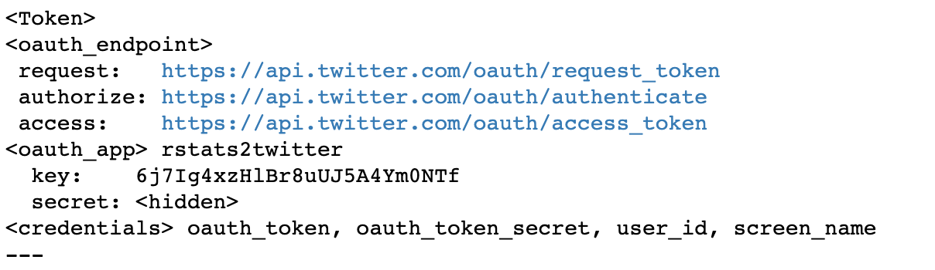
Check:
If you've followed these instructions correctly, the following code should read and print your uploaded token:
(token <- readRDS("~/Desktop/rtweet-token.rds"))

Slide 9
Twitter data!
search_tweets()
Search for one or more keyword(s)
rds <- search_tweets("european computational data journalism conference")
rds
Note: implicit AND between words

Slide 10
search_tweets()
Search for exact phrase
## single quotes around doubles
ds <- search_tweets('"data science"')
## or escape the quotes
ds <- search_tweets("\"data science\"")
ds

Slide 11
search_tweets()
Search for keyword(s) and phrase
rpds <- search_tweets("rstats python \"data science\"")
rpds

Slide 12
search_tweets()
search_tweets() returns 100 most recent matching tweets by default
Increase n to return more (tip: use intervals of 100)
dj <- search_tweets("data journalism", n = 500)
dj
Rate limit of 18,000 per fifteen minutes

Slide 13
search_tweets()
PRO TIP #1: Get the firehose for free by searching for tweets by verified or non-verified tweets
fff <- search_tweets(
"filter:verified OR -filter:verified", n = 10000)
fff
Visualize second-by-second frequency
ts_plot(fff, "secs")

Slide 14
search_tweets()
PRO TIP #2: Use search operators provided by Twitter, e.g.,
filter by language and exclude retweets and replies
rt <- search_tweets("rstats", lang = "en",
include_rts = FALSE, `-filter` = "replies")
filter only tweets linking to news articles
nws <- search_tweets("filter:news")

Slide 15
search_tweets()
filter only tweets that contain links
links <- search_tweets("filter:links")
links
filter only tweets that contain video
vids <- search_tweets("filter:video")
vids

Slide 16
search_tweets()
filter only tweets sent from:{screen_name} or to:{screen_name}certain users
## vector of screen names
users <- c("cnnbrk", "AP", "nytimes",
"foxnews", "msnbc")
paste0("from:", users, collapse = " OR ")
#> "from:cnnbrk OR from:AP OR from:nytimes OR from:foxnews OR
#> from:msnbc"
tousers <- search_tweets(paste0("from:", users, collapse = " OR "))
tousers

Slide 17
search_tweets()
filter only tweets with at least 100 favorites or 100 retweets
pop <- search_tweets(
"(filter:verified OR -filter:verified) (min_faves:100 OR min_retweets:100)")
filter by the type of device that posted the tweet.
rt <- search_tweets("lang:en", source = '"Twitter for iPhone"')

Slide 18
search_tweets()
PRO TIP #3: Search by geolocation (ex: tweets within 25 miles of Columbia, MO)
malaga <- search_tweets(
geocode = "36.7647499,-4.5642737,25mi", n = 1000
)
malaga

Slide 19
search_tweets()
Use lat_lng() to convert geographical data into lat and lng variables.
malaga <- lat_lng(malaga)
par(mar = c(0, 0, 0, 0))
maps::map("world", fill = TRUE, col = "#ffffff",
lwd = .25, mar = c(0, 0, 0, 0),
xlim = c(-8, -2), y = c(34, 40))
with(malaga, points(lng, lat, pch = 20, col = "red"))

Slide 20
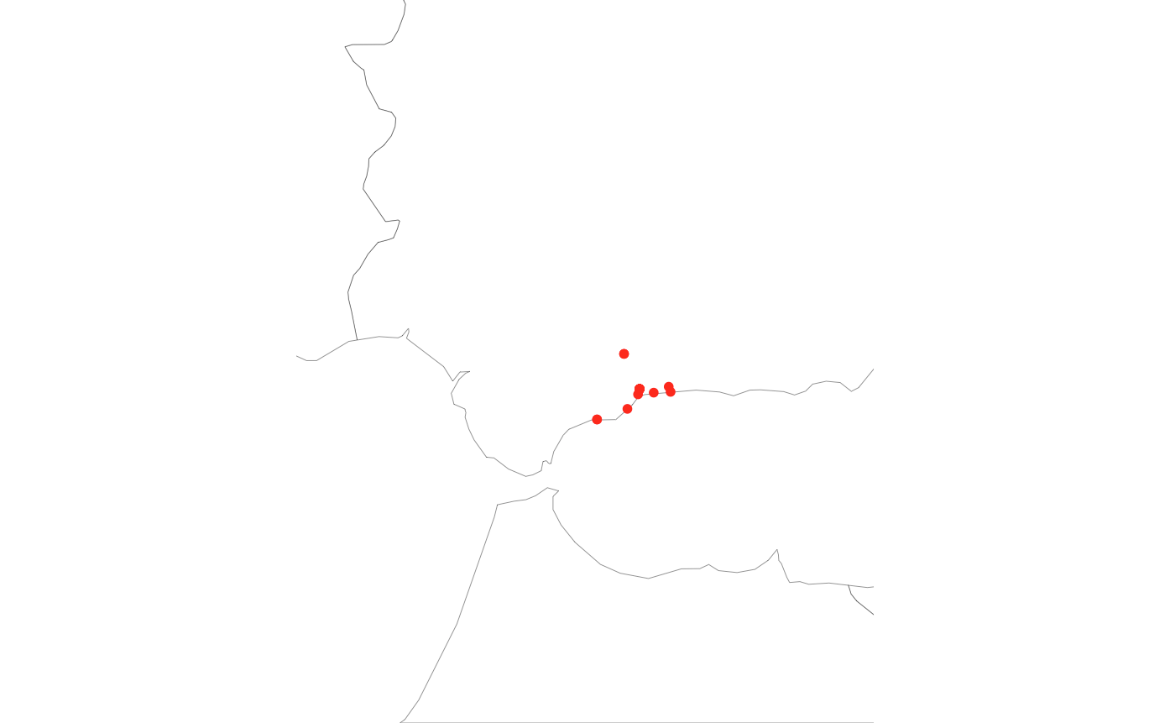

Slide 21
get_timeline()
Get the most recent tweets posted by a user.
cnn <- get_timeline("cnn")

Slide 22
get_timeline()
Get up to the most recent 3,200 tweets (endpoint max) posted by multiple users.
nws <- get_timeline(c("cnn", "foxnews", "msnbc"), n = 3200)

Slide 23
ts_plot()
Group by screen_name and plot hourly frequencies of tweets.
nws %>%
dplyr::group_by(screen_name) %>%
ts_plot("hours")

Slide 24
get_favorites()
Get up to the most recent 3,000 tweets favorited by a user.
nl_favs <- get_favorites("NiemanLab", n = 3000)
nl_favs

Slide 25
Friends/followers
Twitter's API documentation distinguishes between friends and followers.
Friend refers to an account a given user follows
Follower refers to an account following a given user

Slide 26
get_friends()
Get user IDs of accounts followed by (AKA friends) @jack, the co-founder and CEO of Twitter.
fds <- get_friends("jack")
fds

Slide 27
get_friends()
Get friends of multiple users in a single call.
fds <- get_friends(
c("hadleywickham", "NateSilver538", "Nate_Cohn")
)
fds

Slide 28
get_followers()
Get user IDs of accounts following (AKA followers) @datajconf.
djc <- get_followers("datajconf")
djc

Slide 29
get_followers()
Unlike friends (limited by Twitter to 5,000), there is no limit on the number of followers.
To get user IDs of all 55(ish) million followers of @realDonaldTrump, you need two things:
A stable internet connection
Time – approximately five and a half days

Slide 30
get_followers()
Get all of Donald Trump's followers.
## get all of trump's followers
rdt <- get_followers(
"realdonaldtrump",
n = 56000000,
retryonratelimit = TRUE
)

Slide 31
lookup_users()
Lookup users-level (and most recent tweet) associated with vector of user_id or screen_name.
## vector of users
users <- c("hadleywickham", "NateSilver538", "Nate_Cohn")
## lookup users twitter data
usr <- lookup_users(users)
usr

Slide 32
search_users()
It's also possible to search for users. Twitter will look for matches in user names, screen names, and profile bios.
## search for breaking news accounts
bkn <- search_users("breaking news")
bkn

Slide 33
lists_memberships()
Get an account's list memberships (lists that include an account)
## lists that include Nate Silver
nsl <- lists_memberships("NateSilver538")
nsl

Slide 34
lists_members()
Get all list members (accounts on a list)
## all members of congress
cng <- lists_members(owner_user = "cspan", slug = "members-of-congress")
cng

Slide 35
stream_tweets()
Sampling: small random sample (~ 1%) of all publicly available tweets
ss <- stream_tweets("")
Filtering: search-like query (up to 400 keywords)
sf <- stream_tweets("mueller,fbi,investigation,trump,realdonaldtrump")

Slide 36
stream_tweets()
Tracking: vector of user ids (up to 5000 user_ids)
## user IDs from congress members (lists_members ex output)
st <- stream_tweets(cng$user_id)
Location: geographical coordinates (1-360 degree location boxes)
## world-wide bounding box
sl <- stream_tweets(c(-180, -90, 180, 90))

Slide 37
stream_tweets()
The default duration for streams is thirty seconds timeout = 30
Specify specific stream duration in seconds
## stream for 10 minutes
stm <- stream_tweets(timeout = 60)

Slide 38
stream_tweets()
Stream JSON data directly to a text file
stream_tweets(timeout = 60 * 10,
file_name = "random-stream-2019-07-02.json",
parse = FALSE)
Read-in a streamed JSON file
rj <- parse_stream("random-stream-2019-07-02.json")

Slide 39
stream_tweets()
Stream tweets indefinitely.
stream_tweets(timeout = Inf,
file_name = "random-stream-2019-07-02.json",
parse = FALSE)

Slide 40
lookup_coords()
A useful convenience function–though it now requires a Google Maps API key – for quickly looking up coordinates
## stream tweets sent from london
luk1 <- stream_tweets(q = lookup_coords("London, UK"), timeout = 60)
## search tweets sent from london
luk2 <- search_tweets(
geocode = lookup_coords("London, UK"), n = 1000)

Slide 41
Example for practice
1. Search for the top account matching each of the following queries for Donald Trump and Hillary Clinton
clinton <- search_users("hillary clinton", n = 1, verbose = FALSE)
trump <- search_users("donald trump", n = 1, verbose = FALSE)

Slide 42
2. Retrieve up to 1,000 user IDs of accounts that follow @realDonaldTrump and @HillaryClinton
gop <- get_followers("trump", n = 1000)
dem <- get_followers("clinton", n = 1000)

Slide 43
3. Lookup users data for all 2,000 user IDs retrieved in the previous questions.
## get gop users data
gop_data <- lookup_users(gop$user_id)
## get dem users data
dem_data <- lookup_users(dem$user_id)

Slide 44
4. Using the data collected in the last question, add a 'partisan' variable, identifying the observations for each group as "gop" (Republican) or "dem" (Democrat). Merge the data into a single data frame.
## create "partisan" grouping variable
gop_data$partisan <- "gop"
dem_data$partisan <- "dem"
## merge into single data frame
data <- bind_rows(gop_data, dem_data)

Slide 45
5. Group by partisan [group] and summarise the mean number of friends and followers for each group. Print the summary data.
## PRINT: group by partisan and summarise friends and followers counts
data %>%
group_by(partisan) %>%
summarise(
friends = mean(friends_count, na.rm = TRUE),
followers = mean(followers_count, na.rm = TRUE))

Slide 46
6. Plot the summary data you calculated in the previous question.
## PLOT: group by partisan and summarise integer vars
data %>%
mutate(Following = factor(partisan, labels = c("clinton", "trump"))) %>%
group_by(Following) %>%
summarise(
friends = mean(friends_count, na.rm = TRUE),
followers = mean(followers_count, na.rm = TRUE)) %>%
gather(var, count, -Following) %>%
ggplot(aes(x = Following, y = count, fill = Following)) +
geom_col() +
facet_wrap(~ var, ncol = 2, scales = "free_y") +
theme_bw(base_size = 10) +
theme(plot.title = element_text(face = "bold")) +
scale_fill_manual(values = c(trump = "red2", clinton = "blue")) +
labs(
title = "User stats for followers of Donald Trump and Hillary Clinton",
subtitle = "Mean number of friends and followers by group (n = 1000)",
x = NULL, y = "Count")

Slide 47
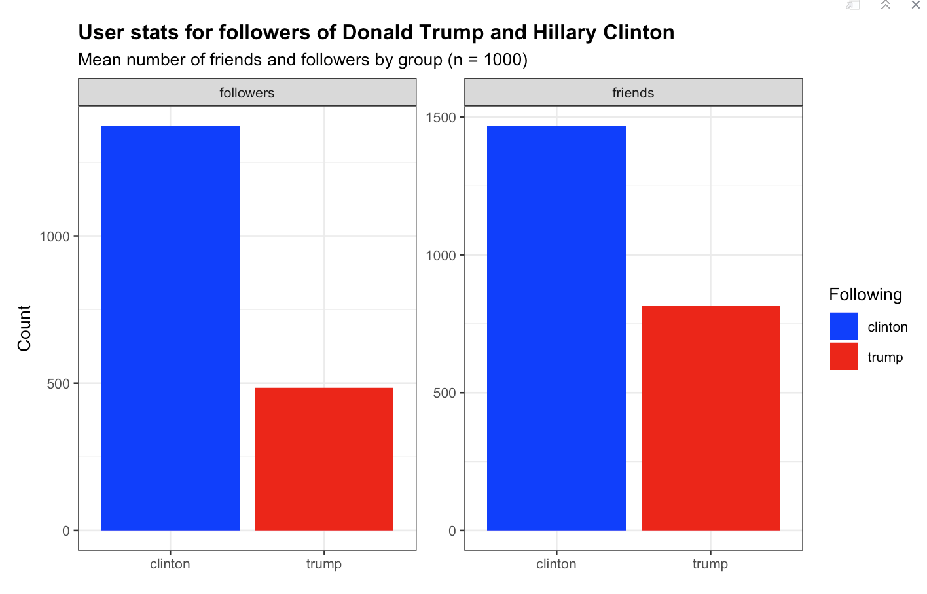

Slide 48
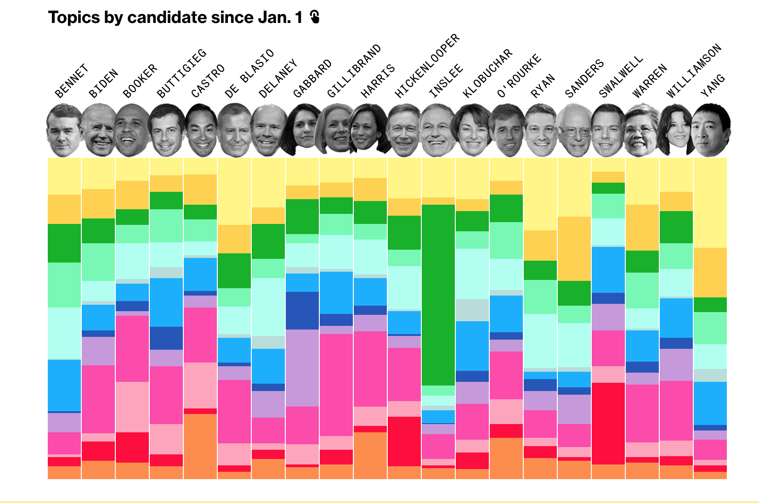
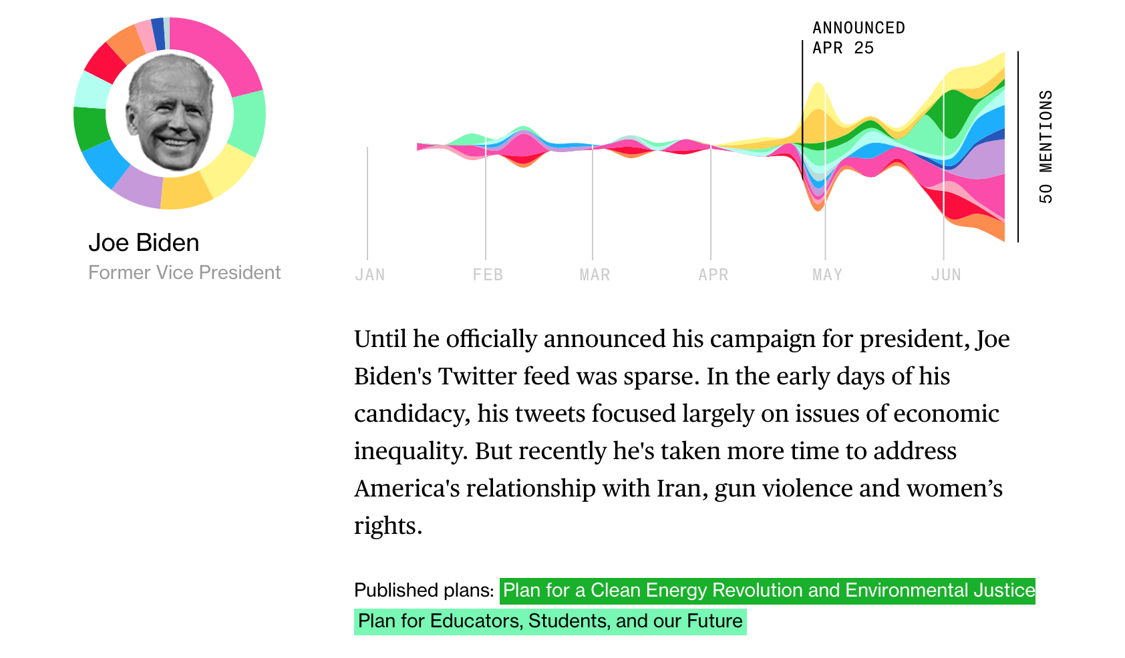
How journalists can use rtweet?
https://www.bloomberg.com/graphics/2020-democratic-presidential-candidate-policies/

Slide 49
How researchers can use rtweet?
We collected tweets from major party candidates in the 2018 midterm elections to analyze systemic differences in the content of tweets depending on features of the candidates.
Our hypotheses
H1: Overperformance will vary as a function of party and number of tweets about health care, migrant caravan, and #metoo
H2: Overperformance will vary as a function of gender and number of tweets about health care, migrant caravan, and #metoo

Slide 50
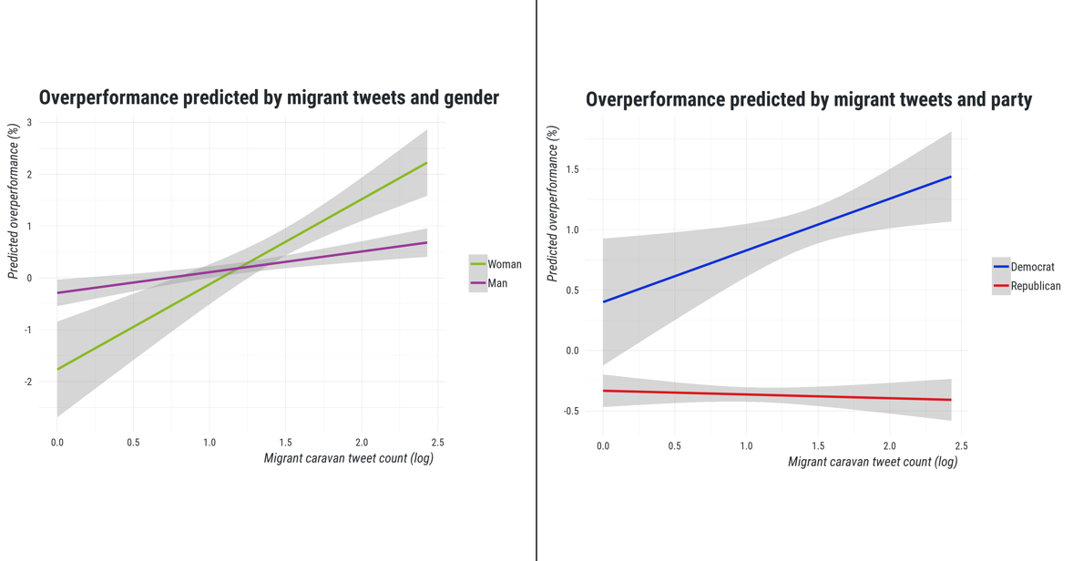
Activity on Twitter cannot serve as a predictor of the election outcome (Overperformance).
Tweeting about migrant caravan is associated with overperformance. On the other hand, tweeting about metoo is related with underperformance
Candidates who tweet about migrant caravan overperform, especially for Democrats and female.

Slide 51
Thank you!
If you have more questions:
My e-mail iuliia.alieva@gmail.com
Twitter @Iuliia_Alieva
Creator of rtweet Michael Kearney
Twitter @kearneymw
Github @mkearney

